Slide 1
Care, Grow and Flourish in God’s Loving Hands
Take a look at our class prayers to thank God for all the ‘wow’ moments and for the things that make us feel good and happy.
These were an outcome of class based collective worship; developing ‘the language of spirituality’.

Slide 2
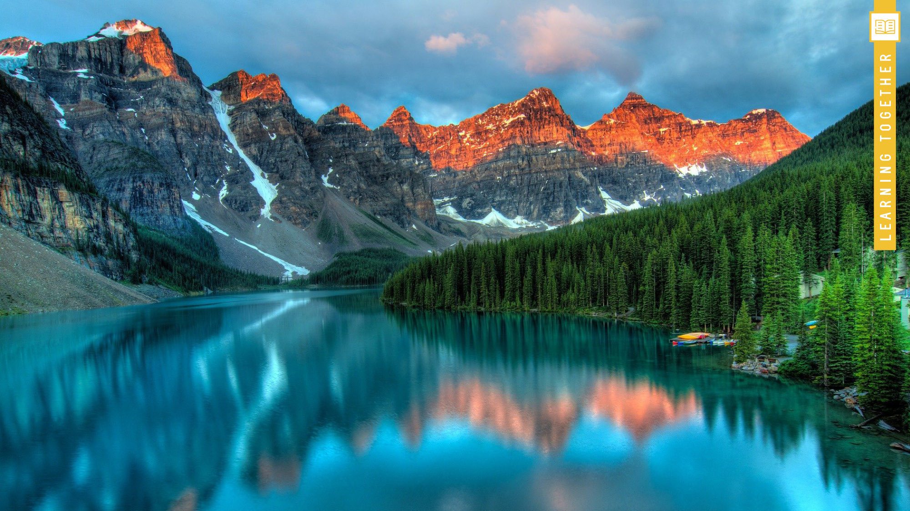
Care, Grow and Flourish in God’s Loving Hands
Dear God,
Thank you for our lovely school, the whole world, our homes, the sun and the trees.
Amen
YR
Dear God,
Thank you for the animals; the ladybirds, the tigers and the snails.
Thank you for rivers and streams and lakes.
Thank you for the plants; the tomatoes, the strawberries and flowers.
Thank you for everything you have made for us.
Amen
Y1
Dear God,
We think wildlife, toys and parks are amazing.
We say wow when we see dogs, peacocks and penguins.
We say wow when we hear birdsong, calm music and loud cat meows.
We are thankful for our food and water.
Amen
Y2

Slide 3
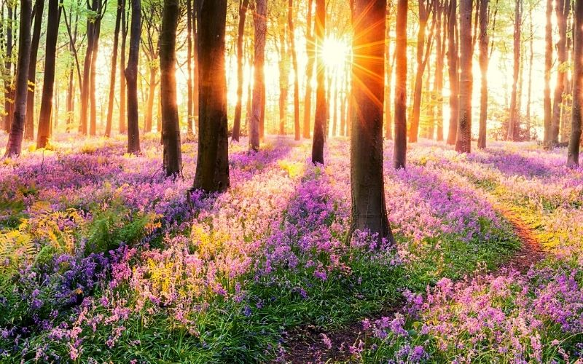
Dear God,
We thank you for creating such an amazing world for us that makes us stop and think wow!
Thank you for beautiful bluebells, blossom trees and orangey pink sunsets.
Thank you for our greenhouses where we can plant and grow vegetables.
Thank you for our dogs, cats and for foxes and snails.
Help us to slow down and appreciate all of the beautiful things you have created for us.
Amen (Y3)

Slide 4
Dear God,
Thank you for our wonderful world,
Thank you for all the bees that give us honey, and for slimy snails.
Thank you for the planets and universe,
Thank you for the blossom on the trees and the oxygen in the air,
Thank you for all the natural colours we can see and enjoy,
Thank you for the sun shining on us,
Thank you for the ocean and the animals that live there,
Thank you for all the tulips we see flourish
Amen
Y4

Slide 5
Dear God,
Thank you all of your creation, for all the beautiful things you have made.
Thank you for the flowers and the trees and the birds – for nature and all living creatures and for amazing buildings that humans have made. Thank you too for Cuffley Camp!
Sorry that some people don’t think about our planet and destroy your beautiful creation. Sorry if sometimes we are mean and upset other people. Please forgive us for what we have done wrong.
Help to guide us on our journey through life.
Amen
Y5

Slide 6
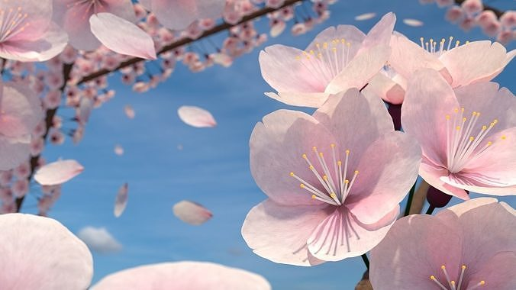
Dear Lord,
Thank you for your beautiful creation, which surrounds us.
For the stunning blossom on trees, which sway in the breeze,
and for spectacular sunsets, which glow on the horizon.
In our troubled world, may this beauty bring peace.
With grateful hearts,
Amen
Y6
Care, Grow and Flourish in God’s Loving Hands

